Slide 1

EXPRESSO CUSTOMER CHURN PREDICTION
Kwame Odoi Otchere

Slide 2
INTRODUCTION
Expresso is an African telco that provides customers with airtime and mobile data bundles
Objective: to develop a machine learning model to predict the chances that a customer will churn
The project will also help Expresso understand and serve their customers better to reduce churn
This project was guided by the CRISP-DM Framework

Slide 3
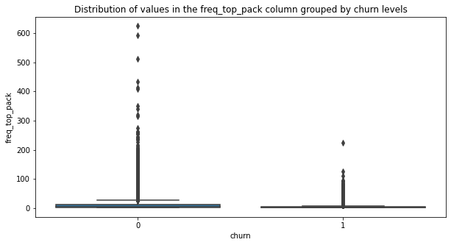
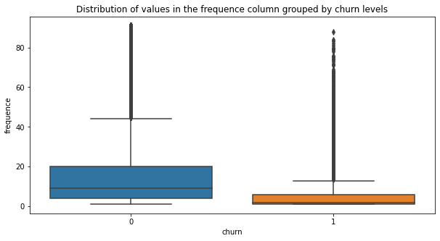
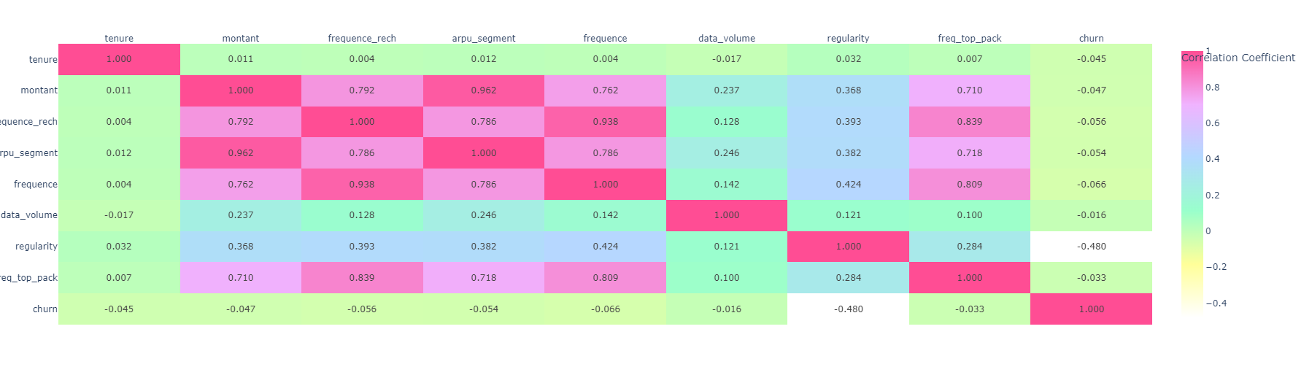
Exploratory data analysis
REGULARITY
TOP PACK FREQUENCY
CORRELATION
Customers who were active for 10 days or more were more likely to stay.
Increase customer activity beyond 10 days to reduce risk of churn
Customers with high top pack frequencies churned less.
Improve top packages to increase frequency of purchases and reduce churn levels indirectly
No column had a positive correlation with churn

Slide 4
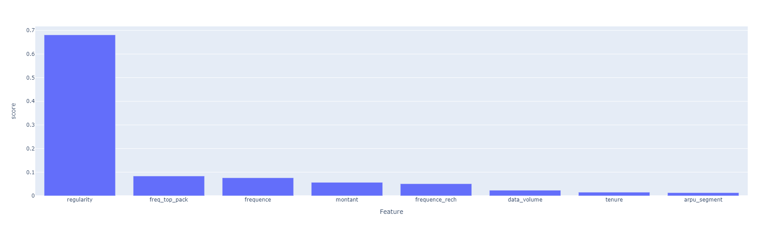
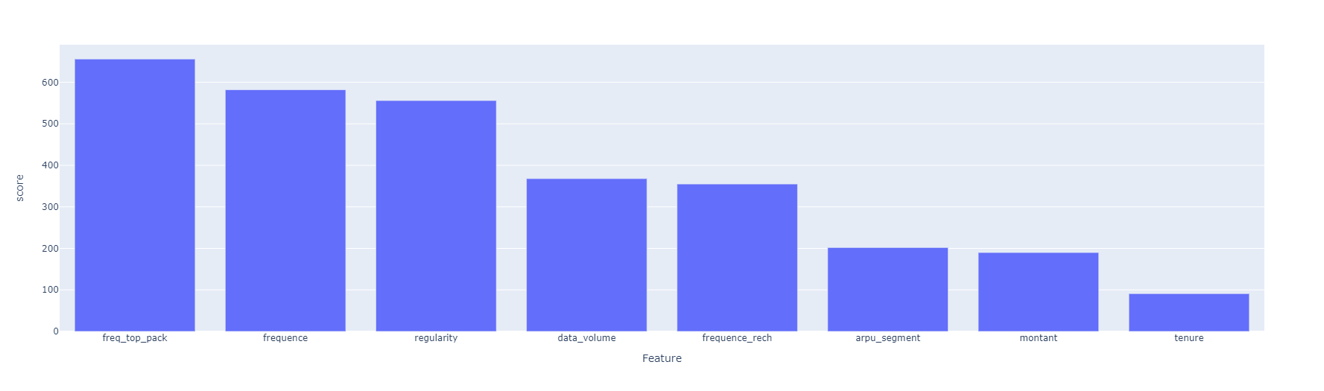
Feature importances
XGBoost Feature Importances
The 3 most important features are:
freq_top_pack
regularity
frequence
LightGBM Feature Importances

Slide 5
SUMMARY
The number of times customers are active per 90 days and the number of times customers activated their top packages were huge determinants of their likelihood of churn.
Expresso may therefore explore these further by engaging customers to understand them and develop strategies to increase active days and improve top packages to reduce churn

Slide 6
THANK YOU
Kwame Otchere
kodoi270@gmail.com
MIRJAM NILSSON
FLORA BERGGREN
President
VP Marketing
Chief Executive Officer
Chief Operations Officer

Slide 7
Links
Notebook: https://colab.research.google.com/drive/1_j2cd48zTlXALqvDZF0DswIPfG7yN0RF
App: https://huggingface.co/spaces/KwameOO/Expresso_Customer_Churn_Predictor
Repo: https://github.com/KOdoi-OJ/Expresso-Customer-Churn-Prediction

